Slide 1
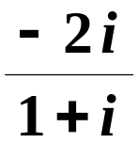


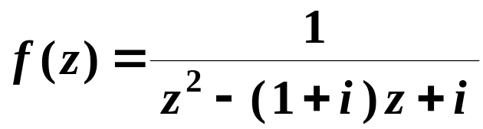

#
C
㗅㑍㙽㨞㭐㛺㖻㑍㚟㧢㩗㐁㖎㐇
o
p
y
r
i
g
h
t
©
2
0
1
4
~
2
0
9
9
.
㭎㐃㩝㞁㩗
(1)
㗅㨞 㔻㡅㪈 㐂
㗯㜖㯥㯫㪈 㐆䶬䶭䶮
®
X
i
e
s
o
n
g
f
a
@
H
U
S
T
.
$
9
8
!
(2)
㙽㨞
㯹㙹㓲㝳㔭 ? 㐄
䍤
䈻
㺖
㙹㓲㝀㫧 ? 㐆䵪䵫䵬䶠䶡䶢
#
C
o
p
y
r
i
g
h
t
©
2
0
1
4
~
2
0
9
9
.
(3)
㔻㯫㪈 㐆䶎䶏䶐䶲䶳
(4)
㙽㨞
㯹 㓲㱖㝷㒼㩚㟵㜄㨞㔻
®
X
i
e
s
o
n
g
f
a
@
H
U
S
T
.
$
9
8
䍤
䈻
㺖
!
㨊㞾㑋㝂㪈 㐆䶔䶕䶖䶝䶞䶟

Slide 2
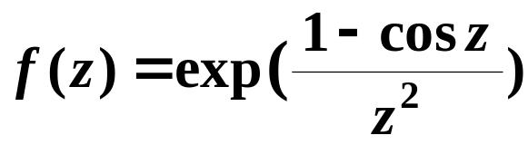
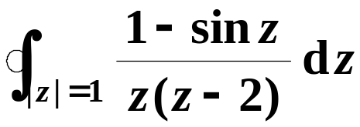



#
C
o
p
y
r
i
g
h
t
©
2
0
1
4
~
2
0
9
9
z
.
(5)
= 0 㪈㙽㨞 㔻㙹㱧㟊㬧㔻㤠㔷 ?
.㐆䶅䶆䶇䶩䶪䶫
®
X
i
e
s
o
n
g
f
a
@
H
U
S
T
.
$
9
8
(6)
㛺㖻 㔻㯫㪈 㐆䵿䶀䶁
!
(7)
㭺㦶 㯹 㓲㔻㬩㰽㜖㪈 㐄
䍤
䈻
㺖
#
C
o
p
y
r
i
g
h
t
©
2
0
1
4
~
2
0
9
9
.
㧼㧔䂇㪈 㐆䵼䵽䵾䶝䶞䶟
(8)
㙽㨞 㔻 Fourier 㑍㚟㪈䶦䶧䶨
®
X
i
e
s
o
n
g
f
a
@
H
U
S
T
.
$
9
8
䍤
䈻
㺖
.㐆䶂䶃䶄䶬䶭䶮
!

Slide 3
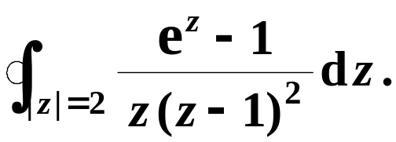
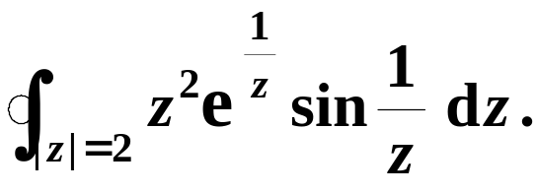
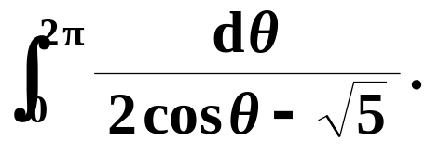
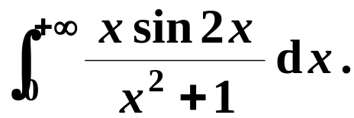




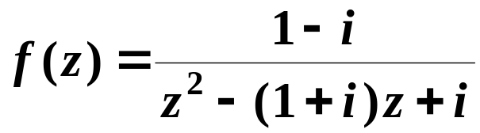


㖎㐃㜘㧒㫉㞸㛺㖻㐆䵼䵽䵾
#
C
o
p
y
r
i
g
h
t
©
2
0
1
4
~
2
0
9
9
.
1.
2.
®
X
i
e
s
o
n
g
f
a
@
H
U
S
T
.
$
9
8
!
3.
4.
㦘㐃
㭬㰝
a
䍤
䈻
㺖
㤴㒺㨞 㭖㛘㙽㨞
#
C
o
p
y
r
i
g
h
t
©
2
0
1
4
~
2
0
9
9
.
㦢㕛 㪈㝀㫧㙽㨞㐂㤂㠝㱣
㦰㐃㛜㙽㨞 㖻㒁㯹 㚋 㓲㱖㝷
®
X
i
e
s
o
n
g
f
a
@
H
U
S
T
.
$
9
8
䍤
䈻
㺖
!
㪈䁻㟥㜄㨞㐆䵶䵷䵸䵿䶀䶁

Slide 4
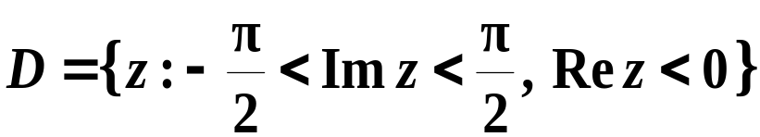
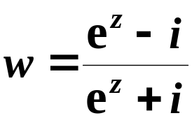









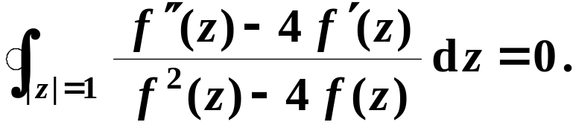
#
C
o
p
y
r
i
g
h
t
©
2
0
1
4
~
2
0
9
9
.
㪊㐃㤴㤞㮾 㯹㭺㦶 㫉
㔻㫑㤞㮾㐆䵪䵫䵬䶯䶰䶱
㟰㐃㤴㑕㤞㮾 㭺㦶㔟㔣㪌㭪㡲㑫㔻
®
X
i
e
s
o
n
g
f
a
@
H
U
S
T
.
$
9
8
!
㘒㬥㭺㦶㐆䶅䶆䶇䶲䶳䶴
㤀㐃㟠㮀 Laplace 㑍㚟㤴㝀㪹㖻㗉㓌㰥㐅䶔䶕䶖
䍤
䈻
㺖
#
C
o
p
y
r
i
g
h
t
©
2
0
1
4
~
2
0
9
9
.
㑯㐃㧞㙽㨞 㯹 㡲㝀㫧㐂㤂㠝㱣
®
X
i
e
s
o
n
g
f
a
@
H
U
S
T
.
$
9
8
䍤
䈻
㺖
!
㰷㠗㐅

Slide 5
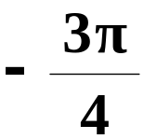


#
C
㗅㑍㙽㨞㭐㛺㖻㑍㚟㧢㩗㐁㖎㐇 㝀㕅
o
p
y
r
i
g
h
t
©
2
0
1
4
~
2
0
9
9
.
㭎㐃㩝㞁㩗
(1)
㗅㨞 㔻㡅㪈 㐂
㗯㜖㯥㯫㪈 㐆䶬䶭䶮
®
X
i
e
s
o
n
g
f
a
@
H
U
S
T
.
$
9
8
!
(2)
㙽㨞
㯹㰙㫫 x = y 㦚
㯹㙹㓲㝳㔭 ? 㐄
㓲㓲㐿㝀㫧
䍤
䈻
㺖
㙹㓲㝀㫧 ? 㐆䵪䵫䵬䶠䶡䶢
#
C
o
p
y
r
i
g
h
t
©
2
0
1
4
~
2
0
9
9
.
(3)
㔻㯫㪈 㐆䶎䶏䶐䶲䶳
(4)
㙽㨞
㯹 㓲㱖㝷㒼㩚㟵㜄㨞㔻
®
X
i
e
s
o
n
g
f
a
@
H
U
S
T
.
$
9
8
䍤
䈻
㺖
!
1
㨊㞾㑋㝂㪈 㐆䶔䶕䶖䶝䶞䶟

Slide 6

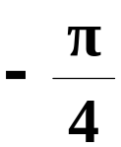

#
C
o
p
y
r
i
g
h
t
©
2
0
1
4
~
2
0
9
9
z
.
(5)
= 0 㪈㙽㨞 㔻㙹㱧㟊㬧㔻㤠㔷 ?
㝳㤊㤠㔷
.㐆䶅䶆䶇䶩䶪䶫
®
X
i
e
s
o
n
g
f
a
@
H
U
S
T
.
$
9
8
(6)
㛺㖻 㔻㯫㪈 㐆䵿䶀䶁
!
(7)
㭺㦶 㯹 㓲㔻㬩㰽㜖㪈 㐄
䍤
䈻
㺖
#
C
o
p
y
r
i
g
h
t
©
2
0
1
4
~
2
0
9
9
.
㧼㧔䂇㪈 㐆䵼䵽䵾䶝䶞䶟
(8)
㙽㨞 㔻 Fourier 㑍㚟㪈䶦䶧䶨
®
X
i
e
s
o
n
g
f
a
@
H
U
S
T
.
$
9
8
䍤
䈻
㺖
.㐆䶂䶃䶄䶬䶭䶮
!

Slide 7
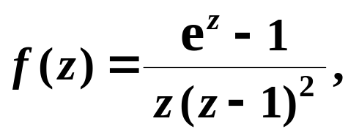

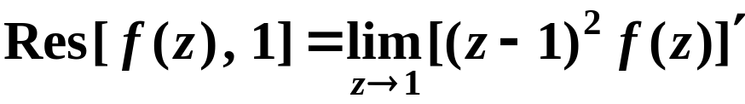
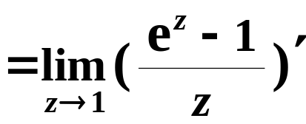
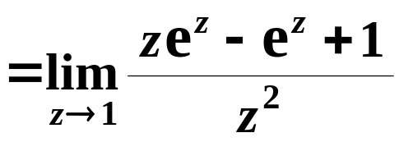


#
C
o
p
y
r
i
g
h
t
©
2
0
1
4
~
2
0
9
9
.
㖎㐃
1.
(1)
㝀䶲䶳䶴
㞴
㯱㭼䵪䵫䵬
®
X
i
e
s
o
n
g
f
a
@
H
U
S
T
.
$
9
8
!
z₁
= 0 㪈 㔻㝳㤊㤠㔷㐂
z₂
= 1 㪈 㔻㖎㜬㛬㔷㐂
䍤
䈻
㺖
#
C
o
p
y
r
i
g
h
t
©
2
0
1
4
~
2
0
9
9
.
®
X
i
e
s
o
n
g
f
a
@
H
U
S
T
.
$
9
8
䍤
䈻
㺖
!
(2)
㭠㦺䵭䵮䵯

Slide 8
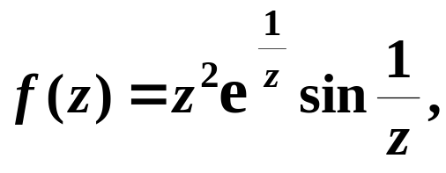
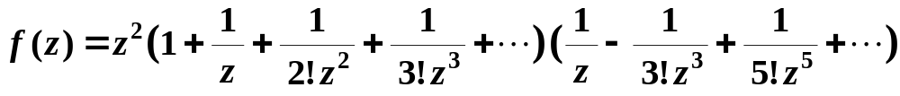
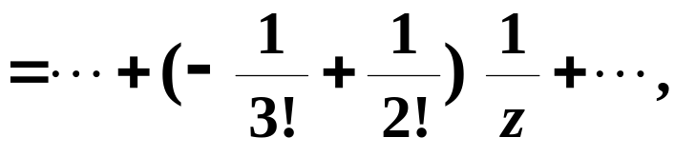
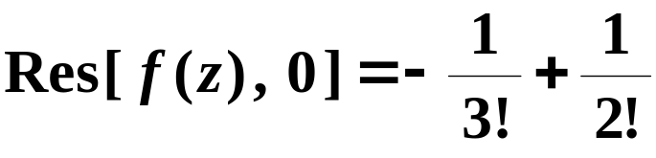
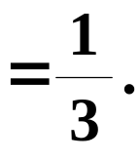
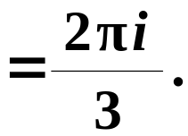

#
C
o
p
y
r
i
g
h
t
©
2
0
1
4
~
2
0
9
9
.
㖎㐃
2.
㝀䶲䶳䶴
z
㞴䶅䶆䶇
㯱 = 0 㪈 㔻㑗㫝㤠㔷㐂䶬䶭
®
X
i
e
s
o
n
g
f
a
@
H
U
S
T
.
$
9
8
!
䍤
䈻
㺖
#
C
o
p
y
r
i
g
h
t
©
2
0
1
4
~
2
0
9
9
.
®
X
i
e
s
o
n
g
f
a
@
H
U
S
T
.
$
9
8
䍤
䈻
㺖
!
㭠㦺䵭䵮䵯

Slide 9
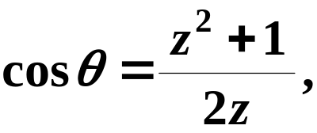
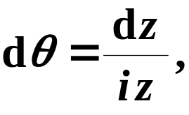

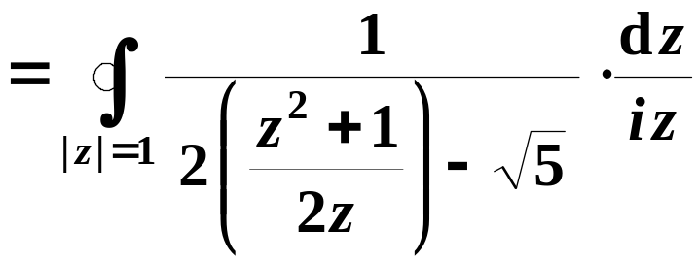
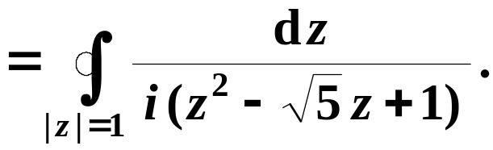
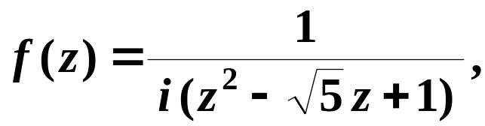




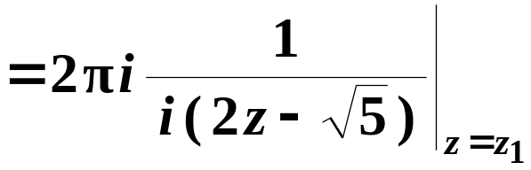


#
C
o
p
y
r
i
g
h
t
©
2
0
1
4
~
2
0
9
9
.
㖎㐃
3.
(1)
㝀䶲䶳䶴
㞴䵪䵫䵬
㯱䶑䶒䶓
®
X
i
e
s
o
n
g
f
a
@
H
U
S
T
.
$
9
8
!
㭠㦺䵭䵮䵯
䍤
䈻
㺖
#
C
o
p
y
r
i
g
h
t
©
2
0
1
4
~
2
0
9
9
.
(2)
㞴䵰䵱䵲
㯱 㭼㟦㙀㭎㜬㛬㔷㐅
㐁 㐿㯹 㡲㐇
®
X
i
e
s
o
n
g
f
a
@
H
U
S
T
.
$
9
8
䍤
䈻
㺖
!
㭠㦺䵭䵮䵯

Slide 10
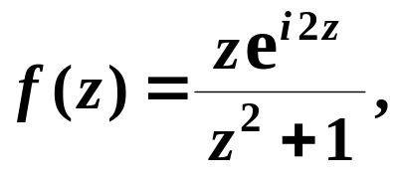

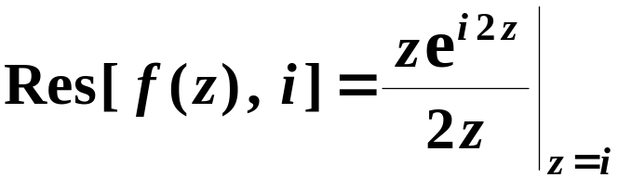
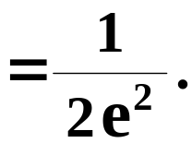
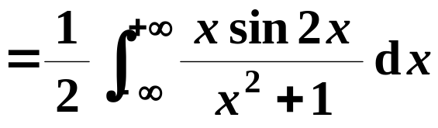
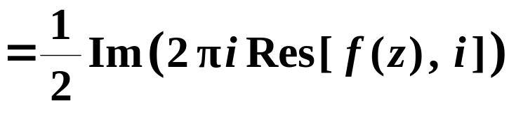

#
C
o
p
y
r
i
g
h
t
©
2
0
1
4
~
2
0
9
9
.
㖎㐃
4.
(1)
㝀䶲䶳䶴
㞴䵼䵽䵾
®
X
i
e
s
o
n
g
f
a
@
H
U
S
T
.
$
9
8
!
㯱 㯹㦚㑋㣛㠩㯵㭼㭎㙀㭎㜬㛬㔷
䍤
䈻
㺖
#
C
o
p
y
r
i
g
h
t
©
2
0
1
4
~
2
0
9
9
.
(2)
㭠㦺䵭䵮䵯
®
X
i
e
s
o
n
g
f
a
@
H
U
S
T
.
$
9
8
䍤
䈻
㺖
!

Slide 11

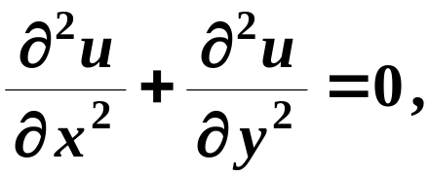




㦘㐃
㭬㰝
a
#
C
㤴㒺㨞 㭖㛘㙽㨞
o
p
y
r
i
g
h
t
©
2
0
1
4
~
2
0
9
9
.
㦢㕛 㪈㝀㫧㙽㨞㐂㤂㠝㱣
(1)
㝀䶲䶳䶴
㧲㫓 㑓㬃㪈䉪㚋㙽㨞㐂
㜶
®
X
i
e
s
o
n
g
f
a
@
H
U
S
T
.
$
9
8
!
䍤
䈻
㺖
#
C
o
p
y
r
i
g
h
t
©
2
0
1
4
~
2
0
9
9
.
㜶㕛䵭䵮䵯
®
X
i
e
s
o
n
g
f
a
@
H
U
S
T
.
$
9
8
䍤
䈻
㺖
!

Slide 12
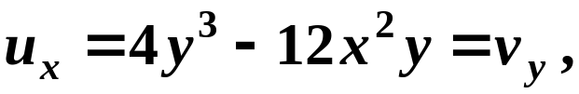



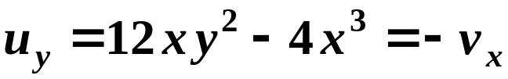




㦘㐃
㭬㰝
a
#
C
㤴㒺㨞 㭖㛘㙽㨞
o
p
y
r
i
g
h
t
©
2
0
1
4
~
2
0
9
9
.
㦢㕛 㪈㝀㫧㙽㨞㐂㤂㠝㱣
(1)
㝀䶲䶳䶴
®
X
i
e
s
o
n
g
f
a
@
H
U
S
T
.
$
9
8
(2)
!
㗉㗡 1 㟠㮀㣕㛺㖻㗡㤴㝀㐆
㮂䵼䵽䵾
㕛䶈䶉䶊
䍤
䈻
㺖
#
C
o
p
y
r
i
g
h
t
©
2
0
1
4
~
2
0
9
9
.
㮂䶬䶭䶮
㕛䶑䶒
®
X
i
e
s
o
n
g
f
a
@
H
U
S
T
.
$
9
8
䍤
䈻
㺖
!
㜶㕛䶣䶤䶥

Slide 13
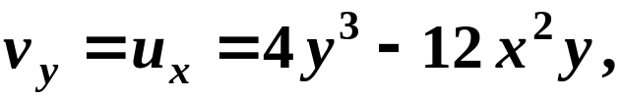
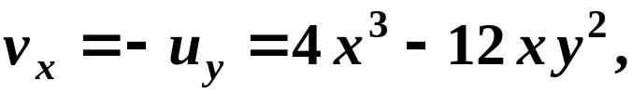


㦘㐃
㭬㰝
a
#
C
㤴㒺㨞 㭖㛘㙽㨞
o
p
y
r
i
g
h
t
©
2
0
1
4
~
2
0
9
9
.
㦢㕛 㪈㝀㫧㙽㨞㐂㤂㠝㱣
(1)
㝀䶲䶳䶴
®
X
i
e
s
o
n
g
f
a
@
H
U
S
T
.
$
9
8
(2)
!
㗉㗡 2 㟠㮀㤄㪹㖻㗡㤴㝀㐆
㮂䵼䵽䵾
䍤
䈻
㺖
㕛䵰䵱䵲
#
C
o
p
y
r
i
g
h
t
©
2
0
1
4
~
2
0
9
9
.
®
X
i
e
s
o
n
g
f
a
@
H
U
S
T
.
$
9
8
䍤
䈻
㺖
!
㜶㕛䵹䵺䵻

Slide 14


㦘㐃
㭬㰝
a
#
C
㤴㒺㨞 㭖㛘㙽㨞
o
p
y
r
i
g
h
t
©
2
0
1
4
~
2
0
9
9
.
㦢㕛 㪈㝀㫧㙽㨞㐂㤂㠝㱣
(1)
㝀䶲䶳䶴
®
X
i
e
s
o
n
g
f
a
@
H
U
S
T
.
$
9
8
(2)
!
(3)
䍤
䈻
㺖
#
㮂䶗䶘䶙
C
o
p
y
r
i
g
h
t
©
2
0
1
4
~
2
0
9
9
.
㜶㕛䶝䶞䶟
®
X
i
e
s
o
n
g
f
a
@
H
U
S
T
.
$
9
8
䍤
䈻
㺖
!

Slide 15

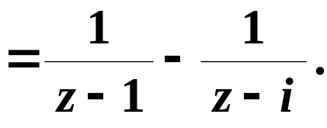

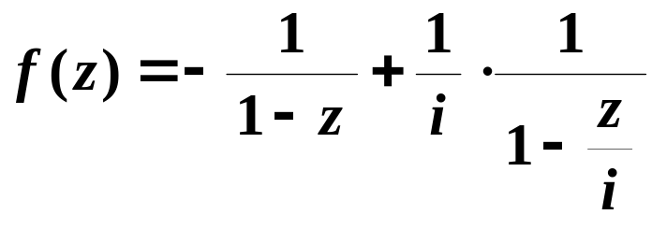

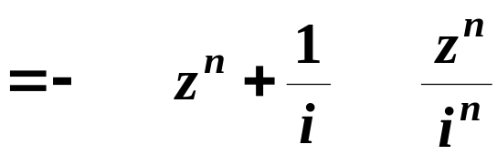
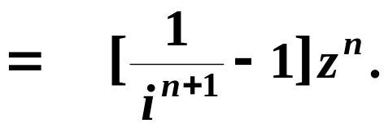


#
C
o
p
y
r
i
g
h
t
©
2
0
1
4
~
2
0
9
9
.
㦰㐃㛜㙽㨞 㖻㒁㯹 㚋 㓲㱖㝷
㪈䁻㟥㜄㨞㐆䵶䵷䵸䵿䶀䶁
㝀䶲䶳䶴
®
X
i
e
s
o
n
g
f
a
@
H
U
S
T
.
$
9
8
!
(1)
z
i
㯹 = 0 㓲㱖㝷㐆䶎䶏䶐
䍤
䈻
㺖
㔳 㧀㐂䶋䶌䶍
#
①
1
C
o
p
y
r
i
g
h
t
©
2
0
1
4
~
2
0
9
9
.
®
X
i
e
s
o
n
g
f
a
@
H
U
S
T
.
$
9
8
䍤
䈻
㺖
!

Slide 16

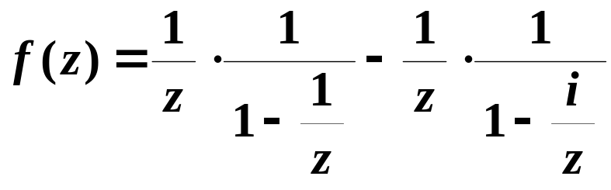
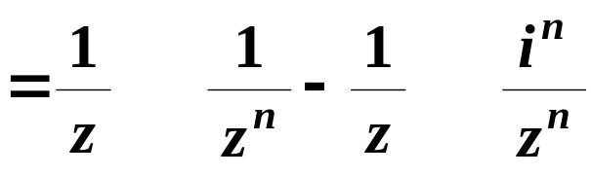
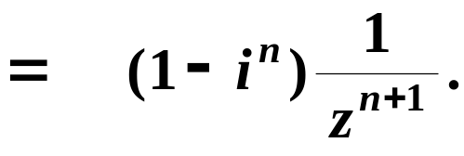
#
C
o
p
y
r
i
g
h
t
©
2
0
1
4
~
2
0
9
9
.
㦰㐃㛜㙽㨞 㖻㒁㯹 㚋 㓲㱖㝷
㪈䁻㟥㜄㨞㐆䵶䵷䵸䵿䶀䶁
㝀䶲䶳䶴
®
X
i
e
s
o
n
g
f
a
@
H
U
S
T
.
$
9
8
!
(1)
z
i
㯹 = 0 㓲㱖㝷㐆䶠䶡䶢
䍤
䈻
㺖
㔳 㧀㐂䶬䶭䶮
#
②
1
C
o
p
y
r
i
g
h
t
©
2
0
1
4
~
2
0
9
9
.
®
X
i
e
s
o
n
g
f
a
@
H
U
S
T
.
$
9
8
䍤
䈻
㺖
!

Slide 17


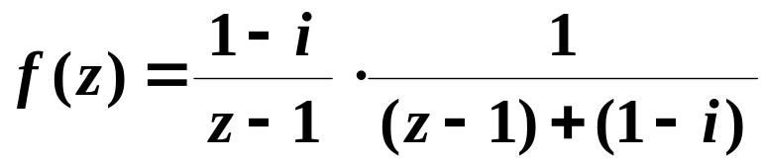
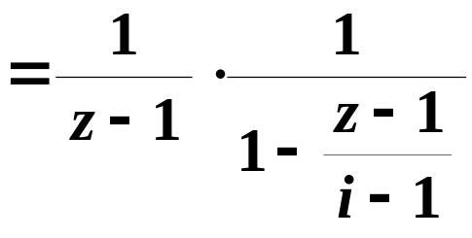
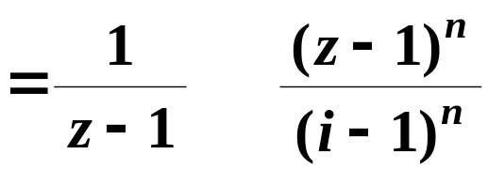

#
C
o
p
y
r
i
g
h
t
©
2
0
1
4
~
2
0
9
9
.
㦰㐃㛜㙽㨞 㖻㒁㯹 㚋 㓲㱖㝷
㪈䁻㟥㜄㨞㐆䵶䵷䵸䵿䶀䶁
㝀䶲䶳䶴
i
®
X
i
e
s
o
n
g
f
a
@
H
U
S
T
.
$
9
8
!
1
(2)
z
㯹 = 1 㓲㱖㝷㐆䶔䶕䶖
䍤
䈻
㺖
㔳 㧀㐂䶗䶘䶙
#
①
C
o
p
y
r
i
g
h
t
©
2
0
1
4
~
2
0
9
9
.
®
X
i
e
s
o
n
g
f
a
@
H
U
S
T
.
$
9
8
䍤
䈻
㺖
!

Slide 18




#
C
o
p
y
r
i
g
h
t
©
2
0
1
4
~
2
0
9
9
.
㦰㐃㛜㙽㨞 㖻㒁㯹 㚋 㓲㱖㝷
㪈䁻㟥㜄㨞㐆䵶䵷䵸䵿䶀䶁
㝀䶲䶳䶴
i
®
X
i
e
s
o
n
g
f
a
@
H
U
S
T
.
$
9
8
!
1
(2)
z
㯹 = 1 㓲㱖㝷㐆䶩䶪䶫
䍤
䈻
㺖
㔳 㧀㐂䵳䵴䵵
#
②
C
o
p
y
r
i
g
h
t
©
2
0
1
4
~
2
0
9
9
.
®
X
i
e
s
o
n
g
f
a
@
H
U
S
T
.
$
9
8
䍤
䈻
㺖
!

Slide 19















#
C
o
p
y
r
i
g
h
t
©
2
0
1
4
~
2
0
9
9
.
㪊㐃㤴㤞㮾 㯹㭺㦶 㫉
㔻㫑㤞㮾㐆䵪䵫䵬䶯䶰䶱
㝀䶲䶳䶴
㞴䶚䶛䶜
㯱䶠䶡䶢
®
X
i
e
s
o
n
g
f
a
@
H
U
S
T
.
$
9
8
!
(z)
(w₁)
(w)
䍤
䈻
㺖
−1
0
#
C
o
p
y
r
i
g
h
t
©
2
0
1
4
~
2
0
9
9
− i
.
㜶㦼㤴㔻㫑㤞㮾㪈㕁㦘㫷㫽㐆
®
X
i
e
s
o
n
g
f
a
@
H
U
S
T
.
$
9
8
䍤
䈻
㺖
!

Slide 20













㟰㐃㤴㑕㤞㮾 㭺㦶㔟㔣㪌㭪㡲㑫㔻
#
C
o
p
y
r
i
g
h
t
©
2
0
1
4
~
2
0
9
9
.
㘒㬥㭺㦶㐆䶅䶆䶇䶲䶳䶴
㝀䶲䶳䶴
(w₁)
(z)
(w₂)
®
X
i
e
s
o
n
g
f
a
@
H
U
S
T
.
$
9
8
!
2
䍤
䈻
㺖
#
C
o
p
y
r
i
g
h
t
©
2
0
1
4
~
2
0
9
9
.
(w)
(w₄)
(w₃)
®
X
i
e
s
o
n
g
f
a
@
H
U
S
T
.
$
9
8
䍤
䈻
㺖
!
1

Slide 21






㤀㐃㟠㮀 Laplace 㑍㚟㤴㝀㪹㖻㗉㓌㰥㐅䶔䶕䶖
#
C
o
p
y
r
i
g
h
t
©
2
0
1
4
~
2
0
9
9
.
®
X
i
e
s
o
n
g
f
a
@
H
U
S
T
.
$
9
8
!
(1)
㝀䶲䶳䶴
㞴䶯䶰䶱
㔫㗉㓌㰥㟦㑥㤌 Laplace 㑍㚟㐂
㑑㕑㥳㒮㯫㐂
㕛
䍤
䈻
㺖
#
C
o
p
y
r
i
g
h
t
©
2
0
1
4
~
2
0
9
9
.
®
X
i
e
s
o
n
g
f
a
@
H
U
S
T
.
$
9
8
䍤
䈻
㺖
!

Slide 22





㤀㐃㟠㮀 Laplace 㑍㚟㤴㝀㪹㖻㗉㓌㰥㐅䶔䶕䶖
#
C
o
p
y
r
i
g
h
t
©
2
0
1
4
~
2
0
9
9
.
®
X
i
e
s
o
n
g
f
a
@
H
U
S
T
.
$
9
8
!
(2)
㝀䶲䶳䶴
㤴㝀㕑㨞㗉㓌㰥㐂
㕛㔟㫑㙽㨞㐅䶣䶤䶥
䍤
䈻
㺖
#
C
o
p
y
r
i
g
h
t
©
2
0
1
4
~
2
0
9
9
.
®
X
i
e
s
o
n
g
f
a
@
H
U
S
T
.
$
9
8
䍤
䈻
㺖
(3)
㤴 Laplace 㡨㑍㚟㐂
㜶㕛䵿䶀䶁
!

Slide 23











㑯㐃㧞㙽㨞 㯹 㡲㝀㫧㐂㤂㠝㱣
#
C
o
p
y
r
i
g
h
t
©
2
0
1
4
~
2
0
9
9
.
㰷㠗㐅
®
X
i
e
s
o
n
g
f
a
@
H
U
S
T
.
$
9
8
(1)
㮂㙽㨞 㯹 㡲㝀㫧㐂䶑䶒䶓
!
㰷㠗䶢䶣
㕥㯹 㡲㝀㫧㐄
( A )
䍤
䈻
㺖
㮂䶑䶒䶓
㝳㕛
#
C
o
p
y
r
i
g
h
t
©
2
0
1
4
~
2
0
9
9
.
㤂䶔䶕䶖
( B )
®
X
i
e
s
o
n
g
f
a
@
H
U
S
T
.
$
9
8
䍤
䈻
㺖
!

Slide 24


㑯㐃㧞㙽㨞 㯹 㡲㝀㫧㐂㤂㠝㱣
#
C
o
p
y
r
i
g
h
t
©
2
0
1
4
~
2
0
9
9
.
㰷㠗㐅
®
X
i
e
s
o
n
g
f
a
@
H
U
S
T
.
$
9
8
证明
(2)
㮂 ( A ) 㚋 ( B ) 㐂
㝳㰝䵧䵨䵩
!
㯹 㡲㝀㫧㐂䵰䵱䵲
䍤
䈻
㺖
#
C
o
p
y
r
i
g
h
t
©
2
0
1
4
~
2
0
9
9
.
㘤㾦㞗㬅㛺㖻㔩㟂㐂
㜶㕛䶝䶞䶟
®
X
都在 内解析；
( A )
i
e
s
o
n
g
f
a
@
H
U
S
T
.
$
9
8
䍤
䈻
㺖
!
( B )

Slide 25

#
C
o
p
y
r
i
g
h
t
©
2
0
1
4
~
2
0
9
9
.
®
X
i
e
s
o
n
g
f
a
@
H
U
S
T
.
$
9
8
!
䍤
䈻
㺖
#
C
o
p
y
r
i
g
h
t
©
2
0
1
4
~
2
0
9
9
.
®
X
i
e
s
o
n
g
f
a
@
H
U
S
T
.
$
9
8
䍤
䈻
㺖
!
……
放松一下吧 !

